Slide 1
ChatGPT and DALL-E for Text to Image conversion

Slide 2
In this PowerPoint, I will try to demonstrate how ChatGPT, and DALL-E can be used for Text to Image conversion.
First, we must obtain the ChatGPT and DALL-E API keys.
We can obtain the ChatGPT API key by inspecting the element on the ChatGPT website, clicking on the Application, and then clicking on https://chat.openai.com. In the first row, we will find a name like '__Secure-next-auth.session-token' along with a value. That value will serve as the ChatGPT API key.

Slide 3
How can ChatGPT be used for Text-to-Image conversion?
It is not possible to convert text to images using ChatGPT or any other natural language processing model. Text-to-image conversion, also known as text-to-image synthesis, is the process of synthesizing an image to represent a given textual description. This task requires a model that comprehends the text's meaning and generates an image that corresponds to it.
But here’s how we can use ChatGPT. To obtain the image, the prompt must be entered. To obtain a better and more accurate image, we must enter correct input, whereas a human would not enter a formal, correct-structured sentence. We will use ChatGPT to generate this prompt, and then send it to DALL-E.
I've written python code that combines ChatGPT's prompt with the DALL-E AI image generator to produce the image.

Slide 4
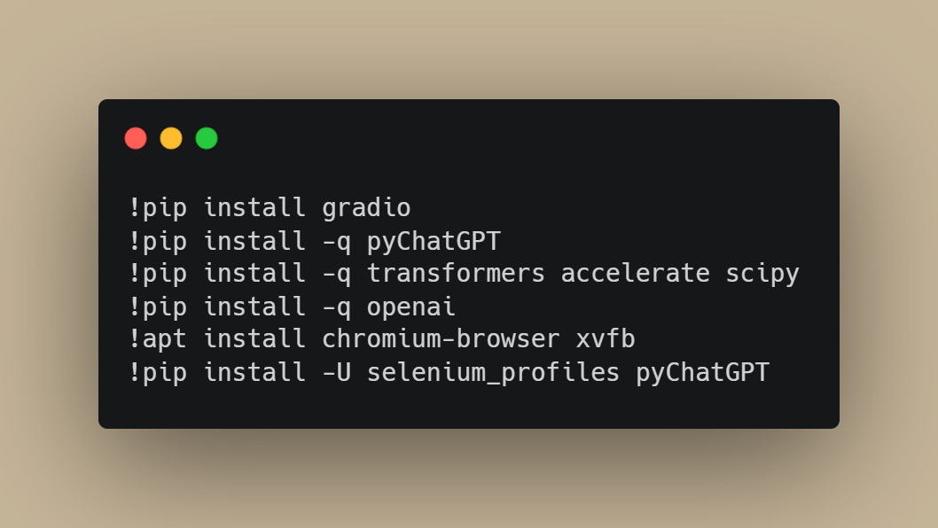
Here the code and its explanation begin

Slide 5
Explanation of the above code
Several Python packages are installed using the pip package manager in the preceding code.
pip is a command-line utility for installing and managing Python packages. It is pre-installed with the Python programming language and is used to install packages from the Python Package Index (PyPI), a repository of software for the Python programming language.
Here is a breakdown of the installed packages:
gradio: gradio is a library for developing interactive interfaces for machine learning
pyChatGPT: pyChatGPT is a library for generating chatbot responses using the GPT-3 language model transformers is a library for natural language processing tasks such as language translation and text summarization that uses transformers, a type of neural network architecture.
accelerate: a library for speeding up numerical and scientific calculations
scipy: scipy is a Python library for scientific computing that offers functions for numerical optimization, signal and image processing, linear algebra, and more.
openai: openai is a library for interacting with the OpenAI API, which provides access to OpenAI's machine learning models and tools.
xvfb and chromium-browser are: These programmes allow you to run a web browser in headless mode; they are not Python packages (i.e., without a GUI)
selenium profiles and pyChatGPT: These are being reinstalled with the -U flag, which stands for "upgrade" and instructs pip to install the most recent version of the package, replacing any previous installation.
Notably, some of these packages have dependencies (i.e., they rely on other packages), so installing them may also install their dependencies.

Slide 6
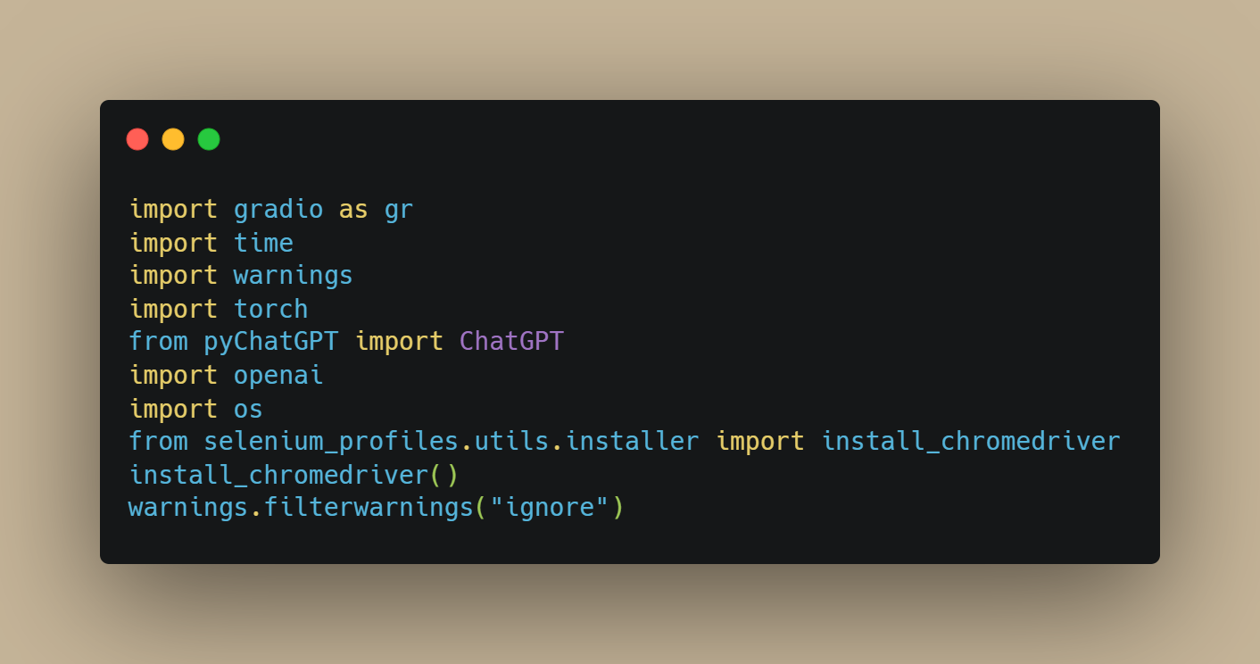

Slide 7
Explanation of the above code
The above code does the following:
Imports several packages and modules. These include:
gradio: a library for building interactive machine learning interfaces
time: a built-in Python module for working with time
warnings: a built-in Python module for issuing warning messages
torch: a popular deep learning library that uses GPU acceleration
ChatGPT: a class from the pyChatGPT library that allows you to generate chatbot responses using the GPT-3 language model
openai: a library for interacting with the OpenAI API, which provides access to various machine learning models and tools developed by OpenAI
os: a built-in Python module for interacting with the operating system
install_chromedriver: a function from the selenium_profiles library that installs the ChromeDriver executable, which allows you to control the Chrome web browser using the Selenium web testing library
Calls the install_chromedriver function to install ChromeDriver.Filters out warning messages using the warnings module. This means that any warning messages generated by the code will not be displayed.
The code does not execute any other actions, as it only consists of import statements and function calls.

Slide 8
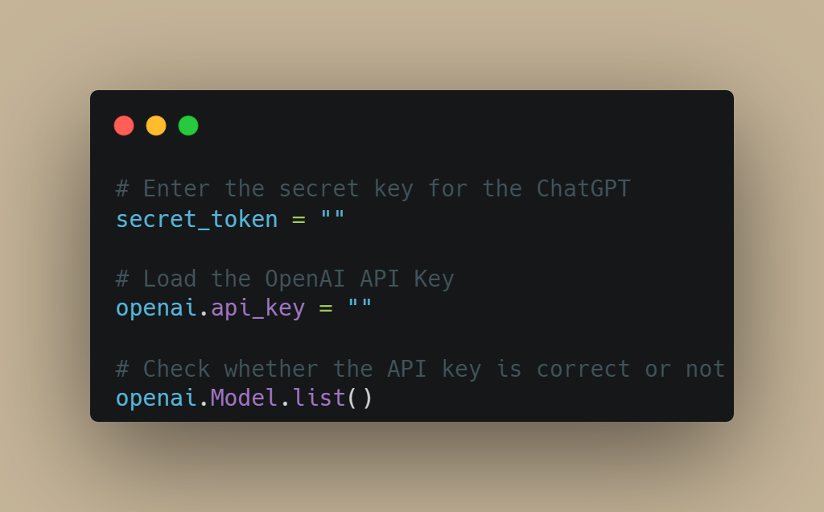

Slide 9
Explanation of the above code
The above code does the following:
Declares two variables: secret_token and openai.api_key. Both variables are assigned empty strings. It's worth noting that openai.api_key is a class attribute of the Model class in the openai library, and it's used to authenticate API requests to the OpenAI API.
Calls the list method of the Model class, which retrieves a list of available models from the OpenAI API. This requires the openai.api_key to be set, as it is used to authenticate the API request.
It's worth noting that the list method returns a list of Model objects, each representing a model available through the OpenAI API. The list includes the model's name, version, and other metadata. You can use this list to select a specific model to use in your application.
It's also worth noting that the secret_token variable is not used in this code. It may be intended for use later in the program.

Slide 10
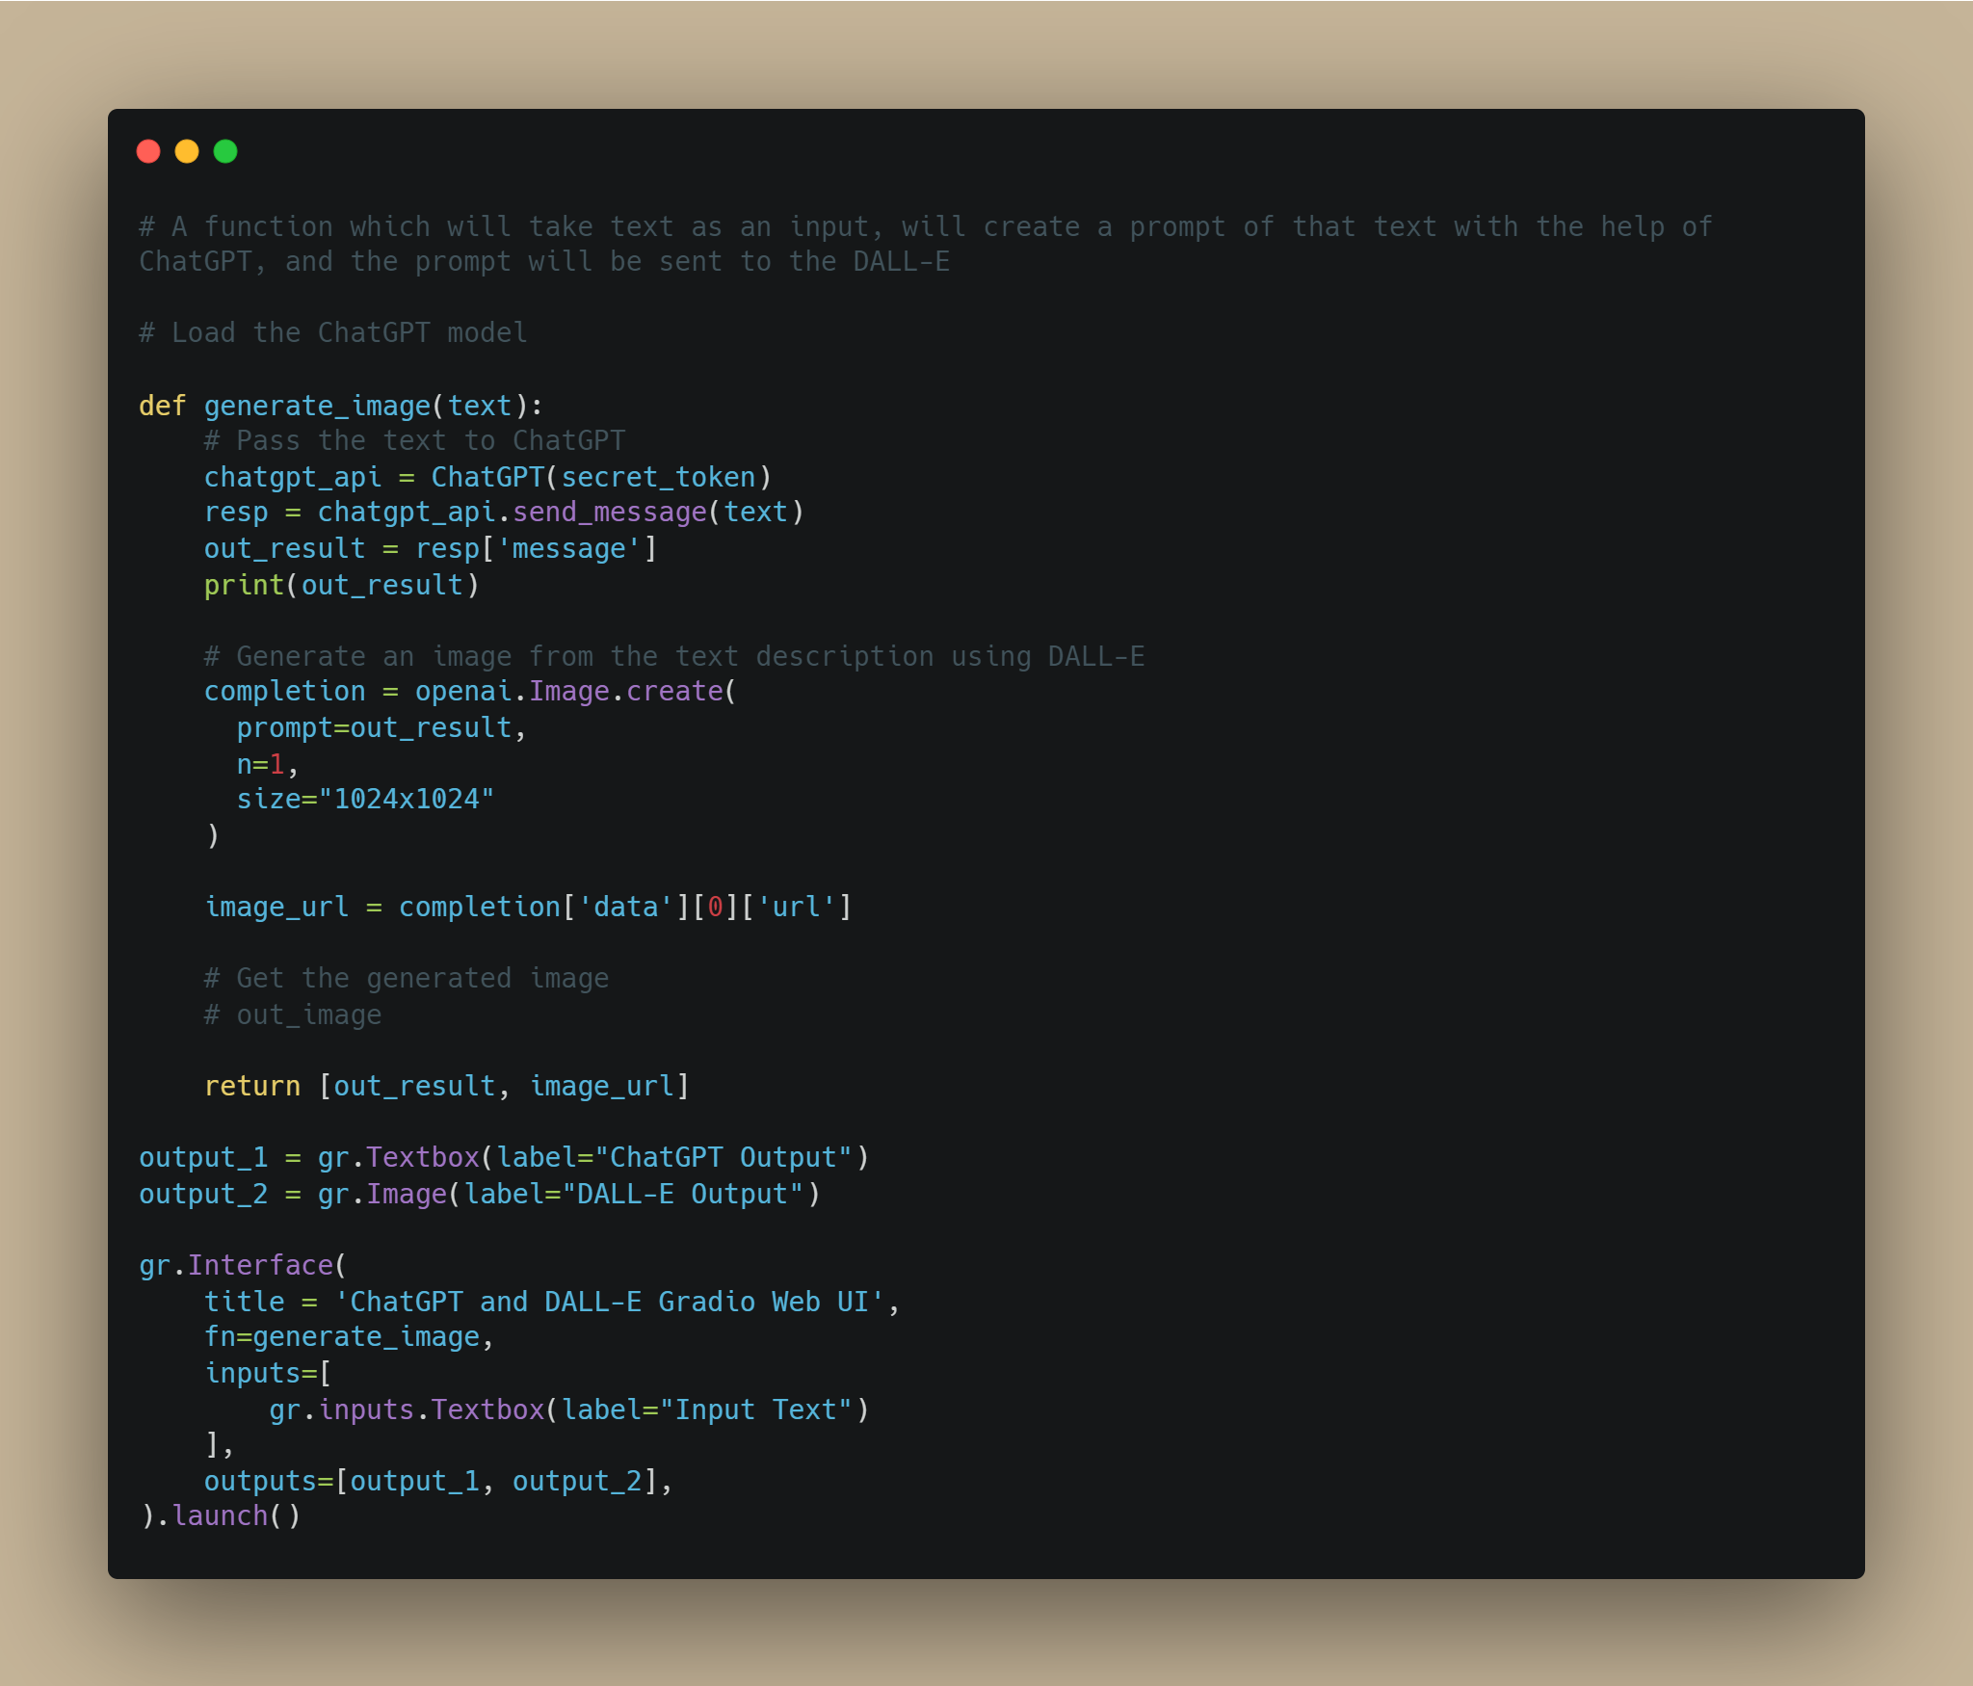

Slide 11
Explanation of the above code
The above code defines a function called generate_image that takes a single argument, text, and generates an image based on a text description using OpenAI's DALL-E API. The function does this by first passing the text to a ChatGPT model, which generates a response based on the input. The response is then passed to the DALL-E API, which generates an image based on the text description.
Here's a more detailed breakdown of what the function does:
Creates an instance of the ChatGPT class from the pyChatGPT library, passing it the secret_token variable.
Calls the send_message method of the ChatGPT instance, passing it the text argument. This sends the text to the ChatGPT model and returns the model's response.
Extracts the model's response from the returned dictionary and assigns it to the out_result variable.
Calls the create method of the Image class from the openai library, passing it the out_result variable as the prompt argument. This generates an image based on the text description using DALL-E.
Extracts the URL of the generated image from the returned dictionary and assigns it to the image_url variable.
Returns a list containing the out_result and image_url variables.

Slide 12
Explanation of the above code (Continued)
The code also defines two output widgets: a textbox called output_1 and an image widget called output_2. It then creates an interface using these widgets and the generate_image function as the function to be called when the interface is used. Finally, it launches the interface.
When the interface is used, the user can enter some text in the textbox, and the generate_image function will be called with the entered text as the argument. The function will generate an image based on the text using the ChatGPT and DALL-E models, and the image and the text description will be displayed in the interface's output widgets.

Slide 13
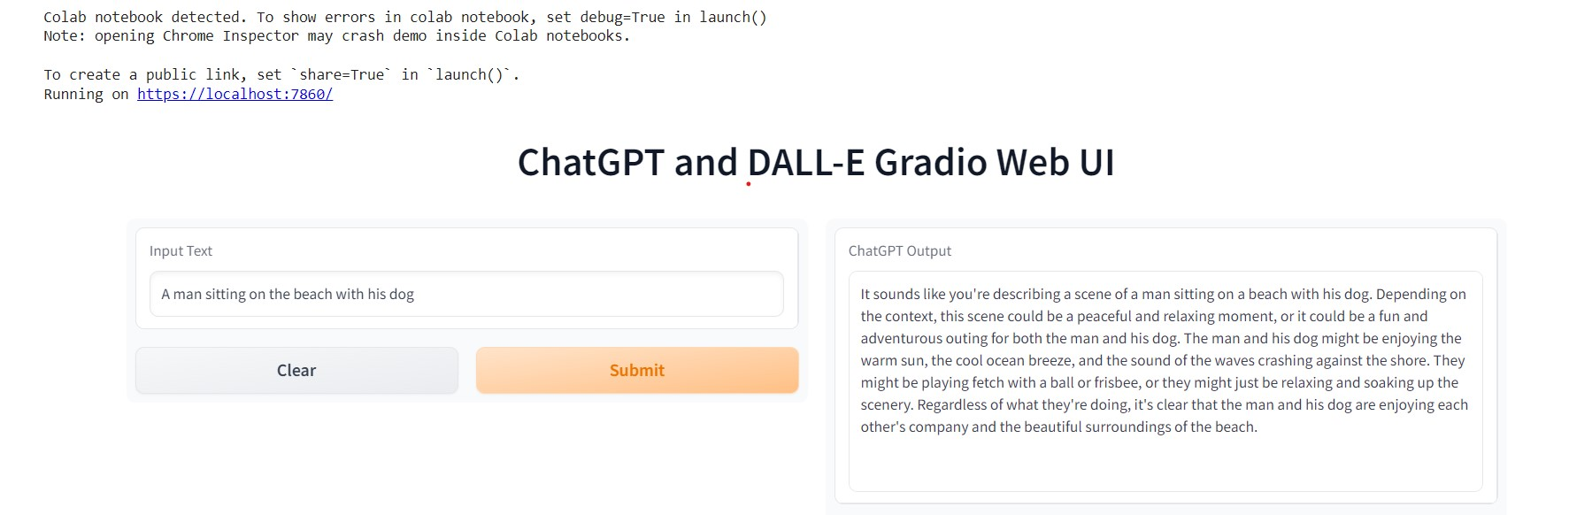
Below is the output

Slide 14
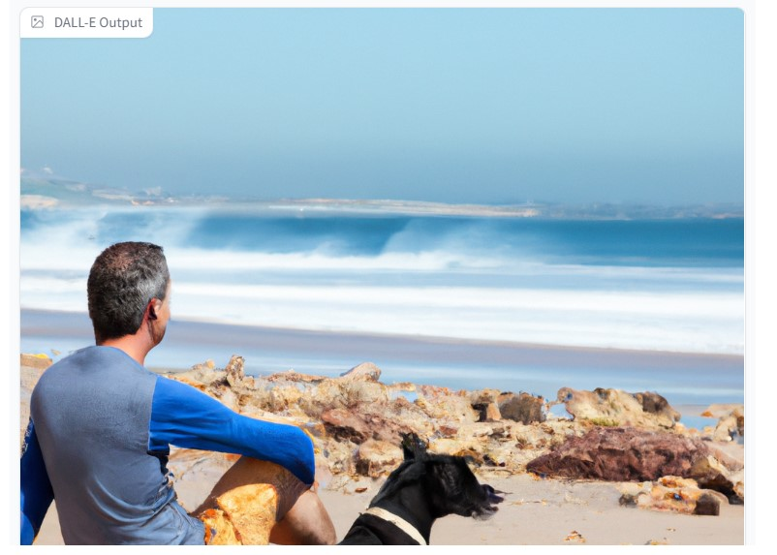
Below is the output (Continued)

Slide 15
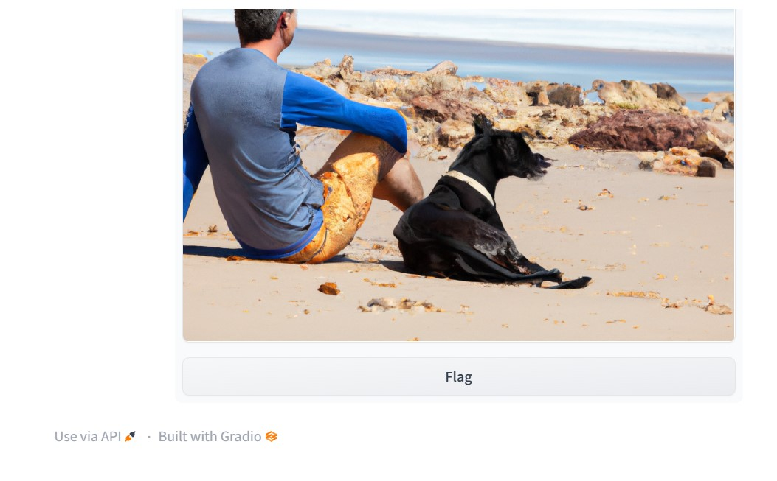
Below is the output (Continued)

